Slide 1
Public Workshop
County GSAs “white area”
August 2, 2021, 3-5 p.m.
Outreach Materials
Drought and Domestic Well Workshop
Conservation Webinar
Allocation Questions
Rate Study Update

Slide 2
Outreach
Mailing sent to all growers outlining allocation and programs being developed

Slide 3
Drought and Domestic Well Workshop
Hybrid Workshop on July 20 at 3 p.m.
  There are funds from the state available to help with dry wells or wells with water quality issues
  Approximately 50 people attended including
    residents
    local and state agencies
    local non-profits
  For help with emergency water services, call Self-Help and leave a message
    (559) 802-1685 for help

Slide 5
Allocation Approach Definitions
Sustainable yield (SY) – water that naturally exists in the subbasins from seepage and percolation
Transitional water (TW) – water that is continued overdraft
Allocation – a water budget of SY and TW that will decrease from 2020-2040
Farm unit – a group of parcels that can manage an allocation as a whole
Notes:
Dispute procedure for meter data vs. ETAW (does this need to be its own resolution?)

Slide 6
June 8, 2021 Summary of Resolution
Resolution did the following:
  Allocated SY and TW water to County GSA irrigated acres in Madera, Chowchilla and Delta-Mendota Subbasins for 2020-2025
  Used 2020 ETAW to determine TW baseline
  Set eligibility limits for TW access to lands irrigated as of June 8, 2021 or last irrigated as recently as January 1, 2015
  Preserves opportunity to access SY for all acres
Notes:
Dispute procedure for meter data vs. ETAW (does this need to be its own resolution?)

Slide 7
Allocation Questions
  Is there an allocation?
  How do I opt in?
  How is my acreage calculated for the allocation?
  What if I want to plant never irrigated land now?
  How are the farm units created?
  What happens if I retire land within my farm unit? What happens if I already retired land?
  Can I carry over water from year to year?
  What happens with changes in leasing or buying/selling?
  How can I get credit for recharge?
  How can I appeal?
Notes:
Dispute procedure for meter data vs. ETAW (does this need to be its own resolution?)

Slide 8
Is there an allocation?
Yes

Slide 9
How do I opt in?
No later than December 1 of each year, parcels that are subject to the GSA Admin fee will receive an allocation of SY and TW for the next calendar year
No later than December 1 of each year, eligible parcels for SY (that are not paying the GSA Admin fee) may opt in for SY for the following calendar year by demonstrating that water will be put to use on the eligible parcel
Nothing in this prevents water for domestic use or stock water

Slide 10
How is my acreage calculated?
Multiple estimates of acreage within a parcel currently exist including:
  Assessor’s acreage
  DWR’s GIS measurements of irrigated acreage are used in Irriwatch
  Acreage that are part of irrigated agricultural operations or permitted confined animal operations
  Other numbers from crop insurance or other vendors or our own measurements

Slide 11
How is my allocation calculated?
Calculate SY allocation
  SY is total acreage in APN (assumed to be irrigated acres)
Calculate TW allocation
  TW is based on irrigated acreage and/or confined animal facility operation area
  Irrigated acreage may be increased up to 10%
  Quantity will not exceed APN acreage
Total allocation for eligible parcels =
SY allocation + TW allocation

Slide 12
What if I want to plant never irrigated land now?
You are in a critically-overdrafted subbasin
Never irrigated lands can access only SY using opt in process
Must demonstrate need for use of water
Never irrigated lands cannot be part of a farm unit

Slide 13
How are farm units created?
  GSA must approve
  Currently set up by registration to Irriwatch for irrigated lands, but will all be reviewed individually
  Must be eligible acres (currently irrigating or previously irrigating or part of CAFO, etc.)
  Any other land that opts in cannot be part of a farm unit (e.g. never irrigated)

Slide 14
What happens if I retire land?
When irrigated acres are taken out of production, SY and TW could be used elsewhere on irrigated acres within the approved farm unit; if land was taken out of irrigated production after January 1, 2015, it is eligible for SY and TW and to be in farm unit
If you were to participate in the SALC program (and be paid), the County GSA is buying your SY and TW and it can’t be used elsewhere
Notes:
Dispute procedure for meter data vs. ETAW (does this need to be its own resolution?)

Slide 15
Can I carry over water?
Unused SY and TW could be carried over (calculated as the difference between allocation and actual use on farm unit):
  Assume that current year SY is used first
  Fees for SY and TW need to be paid for the full amount
  Carried over water decreases by 10% in first year and 25% in the following years

Slide 16
How will changes in leasing or buying/selling be handled?
If land is bought/sold or management changes, and the County is notified in writing no later than December 1, County GSA will allow a farm unit to modify the makeup of its parcels to reflect changes in allocation to be reflected in following year
Notes:
Dispute procedure for meter data vs. ETAW (does this need to be its own resolution?)

Slide 17
How can I get credit for recharge?
If someone participates in the County GSA recharge program and takes additional water, we anticipate that a credit for recharge could be given on top of the SY + TW allocation
Credit would be proportional to costs and benefits
A meter would be required to measure additional (and new) water that is applied either through on-farm recharge or to a dedicated basin

Slide 18
How can I appeal?
Appeals of ETAW require a flowmeter and you
  must demonstrate that flow meter was installed and maintained per manufacturer’s specs;
  provide an engineer-certified or manufacturer-certified calibration report within two calendar years of the appeal; and
  take meter reads monthly and with a photo of each meter read
  Conversations have begun with potential independent third parties for evaluation of meter data
  To evaluate the installation and records and see if flow meter records are acceptable
  Grower pays cost of appeal if denied
Notes:
Dispute procedure for meter data vs. ETAW (does this need to be its own resolution?)

Slide 19
Questions/Comments
Notes:
Dispute procedure for meter data vs. ETAW (does this need to be its own resolution?)

Slide 20
Fee Structure Considerations
Irrigated Acreage – Charge per acre
  Acreage is not fixed over time, partially dependent on SALC participation
  Treats all crops equal, example: grapes and nut crops charged the same
Volumetric Rate – Charge per volume
  Allocations are reduced over time, but all water allocated is expected to be taken (Sustainable Yield + Transitional Water)
  Use of the allocation, and therefore charges, account for difference in crop type
Hybrid – Charge per acre and volume
  Specific project(s) cost(s) are recovered through the Irrigated Acreage portion and others through the Volumetric Rate
  In concept the structure approximates a fixed + variable rate, like traditional utility charges

Slide 21
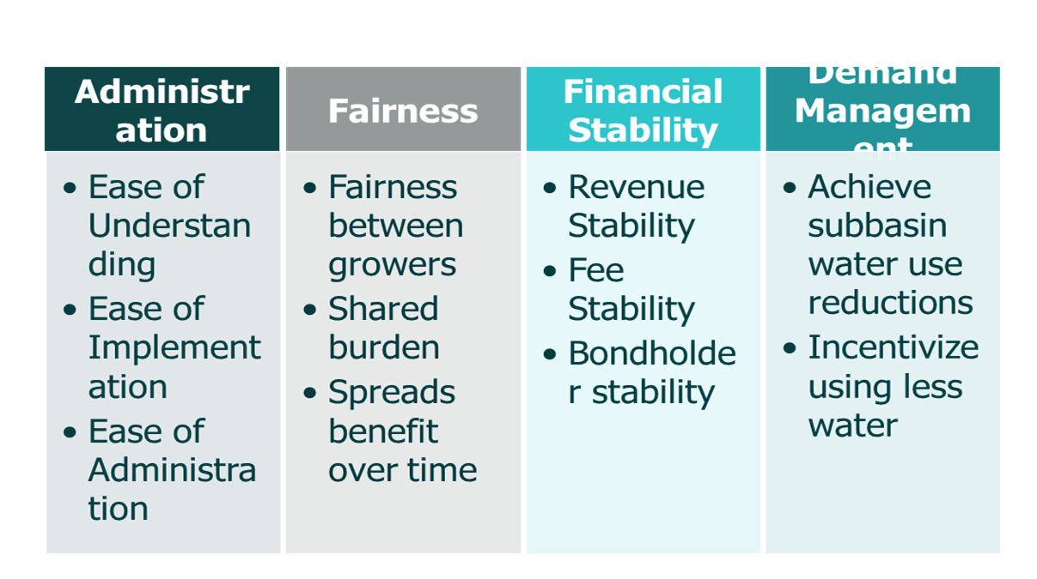
Rate Study – Policy Objectives
Notes:
Dispute procedure for meter data vs. ETAW (does this need to be its own resolution?)

Slide 22
Fee Structure Evaluation
Policy Objective | Irrigated Acreage (Fixed) | Volumetric Rate (Variable) | Hybrid (Fixed + Variable)
Administration
Fairness
Financial Stability
Demand Management
= Least
= Best

Slide 23
Questions/Comments
Notes:
Dispute procedure for meter data vs. ETAW (does this need to be its own resolution?)

