Slide 1
Streambed Alteration Agreement
The Flood Control and Water Conservation Agency received a final agreement on 4/5/2022
The Board approved a contract with Live Oak Associates on 7/26/2022
Pre-activity surveys are needed by biologist now.
In general, activities in the channel are allowed from August – May

Slide 2
Chowchilla River
Ash Slough
Berenda Slough
Dry Creek
Fresno River
Notes:
Only these waterways; not the foothills

Slide 3
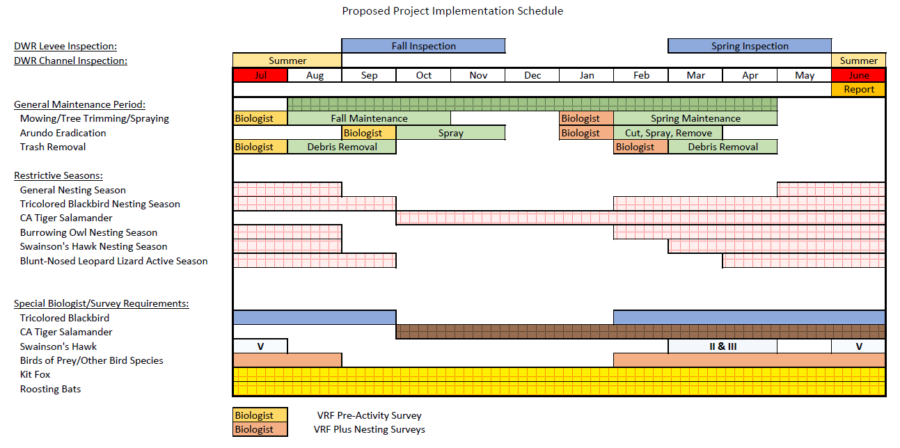

Slide 4
Public Works
Opportunity to work with Public Works on mowing in channel
Agency owns Green Climber and excavator with mowing attachment
Coordinate with Roads division on staff time

Slide 5
Chowchilla Water District
Discussions on work for Arundo and vegetation removal
Experience with spraying and mulching of Arundo
Have adequately trained staff and equipment

Slide 6
River Partners
Site visit and meetings with River Partners for Arundo removal
Knowledgeable staff with previous project experience
Working on potential funding opportunities
Waiting for a proposed scope of services and budget

Slide 7
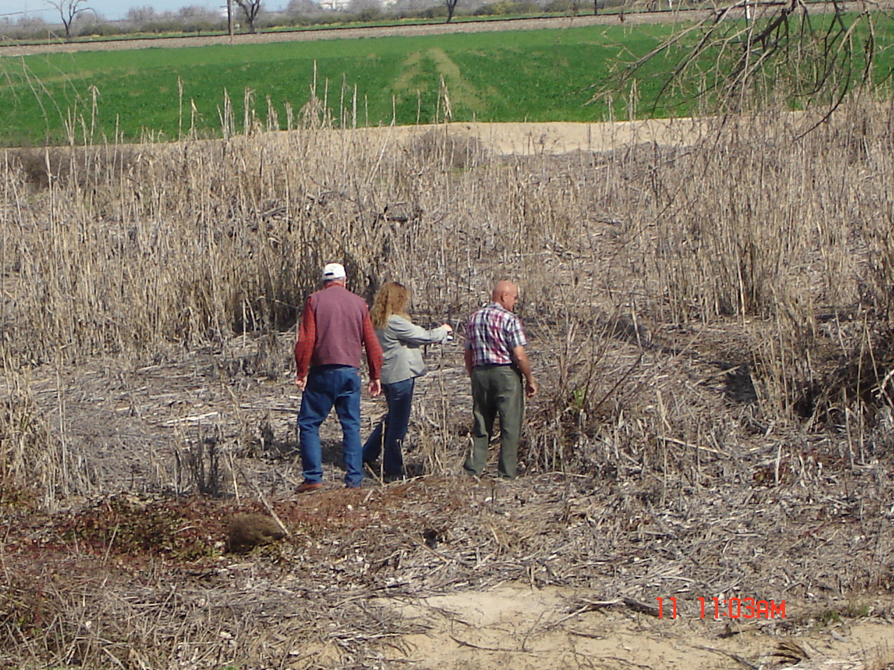
Farmland Maintenance
Similar to Sediment Removal project
Train farmers to remove vegetation on their own land according to the conditions in the 1602 agreement
Existing contract with Live Oak can be used for biologist pre-activity surveys on groups of parcels to make up a project

