Slide 1
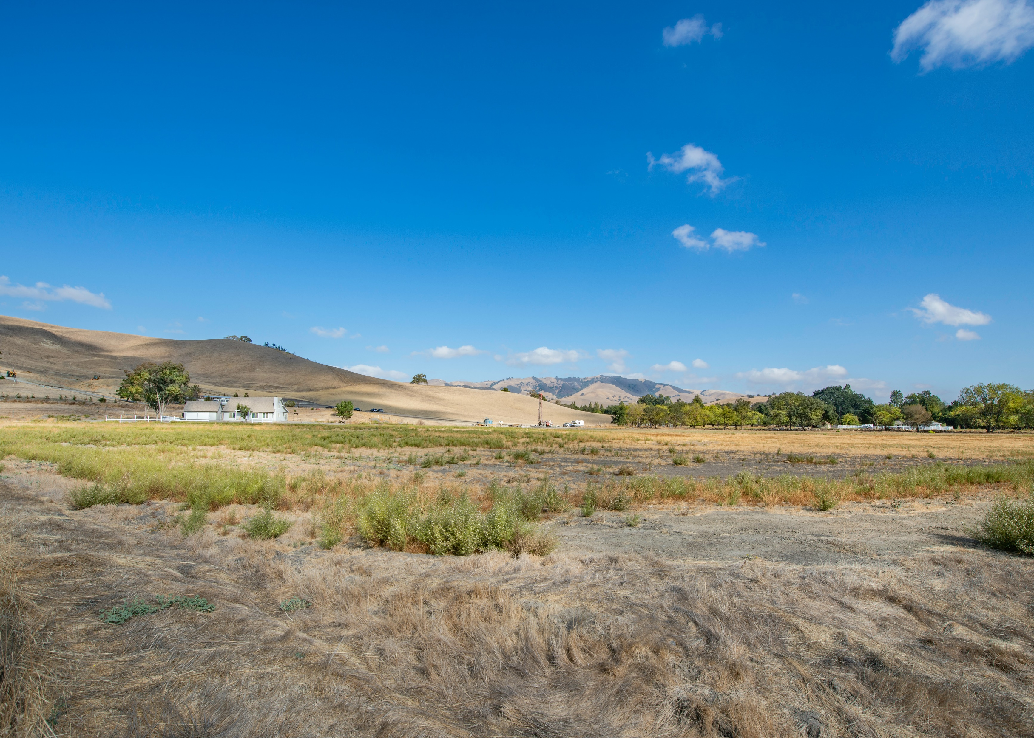
Madera County Drought and Water Shortage Risk Analysis and Response Plan
Pursuant to Senate Bill 552
Photo credit: Cristina Anne Costello, Unsplash

Slide 2
Senate Bill 552 requirements for counties
Establish County Task Force or alternative (the Drought Workgroup)
Assess Drought & Water Shortage Risk
Provide Emergency Drinking Water Solutions
Consider Consolidations for Existing Water Systems
Consider Domestic Well Mitigation Programs
Analyze Steps to Implement the Plan
Consider Local, State, and Federal Funding Sources to Implement Plan
Water Code Section 10609.70

Slide 3
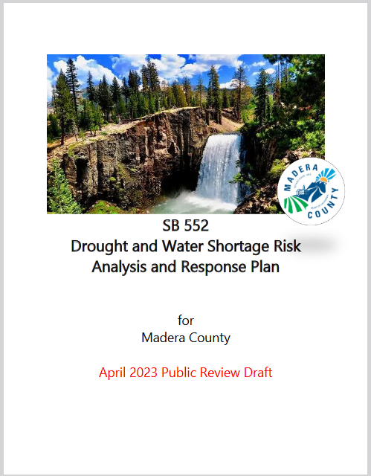
Plan Outline
Introduction and background
Identification of Drought & Water Shortage Risk
Small System Consolidation Opportunities
Shortage Response Actions (Action Plan)
Conclusions and Recommendations

Slide 4
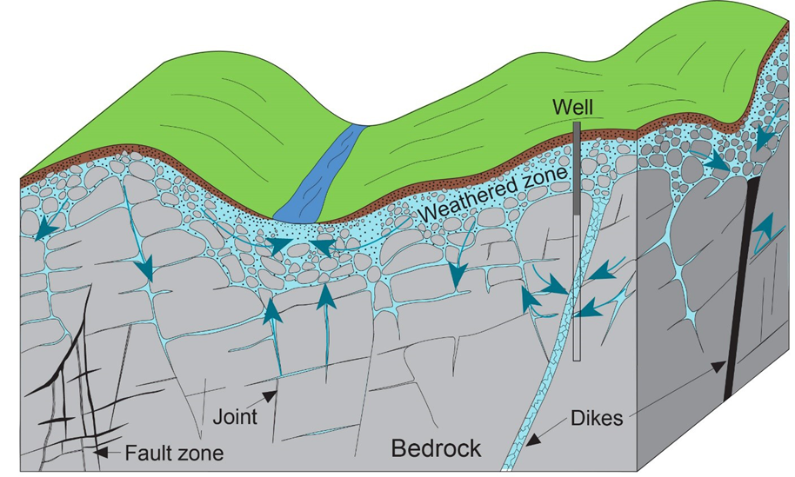
Risk Factors
History of Dry Wells & Future Susceptibility
Less Reliable Wells in Fractured Rock
Social Vulnerability
Image credit: LA Times
Accessed at: https://sgma.water.ca.gov/CalGWLive/#groundwater

Slide 5
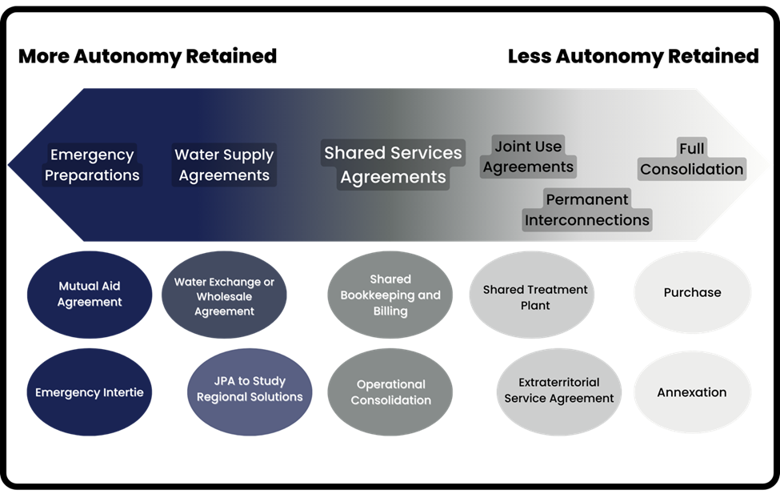
Small System Consolidations
We will NOT be issuing recommendations for specific systems to consolidate. Rather, we are identifying types of opportunities.

Slide 6
Draft Action Plan has a staged approach:
Drought Stage | Tracking Measure |  |  | Response Actions
Drought Stage | GW decline | Dry Wells Reports | Current Year Hydrology | Response Actions
0 | <15 ft | <4 | > 80% of avg SJR runoff | Baseline Actions
1 | 15-30 ft | 5-10 | 50-80% of avg SJR runoff | Moderate Actions
2 | >30 ft | >11 | <50% of avg SJR runoff | Severe Actions

Slide 7
Plan implementation: agency roles
Madera County Sheriff’s OES
Assist in emergency response
Madera County Department of Water & Natural Resources
Lead agency for implementation
Ongoing monitoring
Constituent communication
Coordination with other agencies
No method to raise funding
Self-Help Enterprises
Deliver emergency water
Assist with well reporting & stakeholder outreach
Local GSAs
Groundwater monitoring
Fees fund domestic well mitigation
Department of Water Resources DWR
Funding/ grants
Maintain data portals

Slide 8
Thank you!
Contact:
Jenny Nunez-Rodriguez – Jenny.NunezRodriguez@maderacounty.com
Frank Lyles – flyles@zanjeroams.com
Greg Young – gyoung@zanjeroams.com

Slide 9
Drought Planning for CA Water Suppliers
“Rural Communities” AKA Self-Supplied Communities
Public Water System
Urban Water Suppliers
and Wholesalers
Domestic Wells and other privately supplied homes
Small Water Suppliers
State Small Water Suppliers
3,000
1,000
15
5
More service connections
Fewer service connections
3,000+
2,999 - 1,000
999 - 15
14 - 5
4 - 1
Urban Water Management Plans
Abridged Water Shortage
Contingency Plans
Add Drought Planning Elements to its Emergency Notification or Response Plan
County Responsible for Drought Plan

