Slide 2
Item 4
Request for Feedback: Review of domestic well mitigation fee for Madera Subbasin, Madera County Groundwater Sustainability Agency, Groundwater Sustainability Project

Slide 3
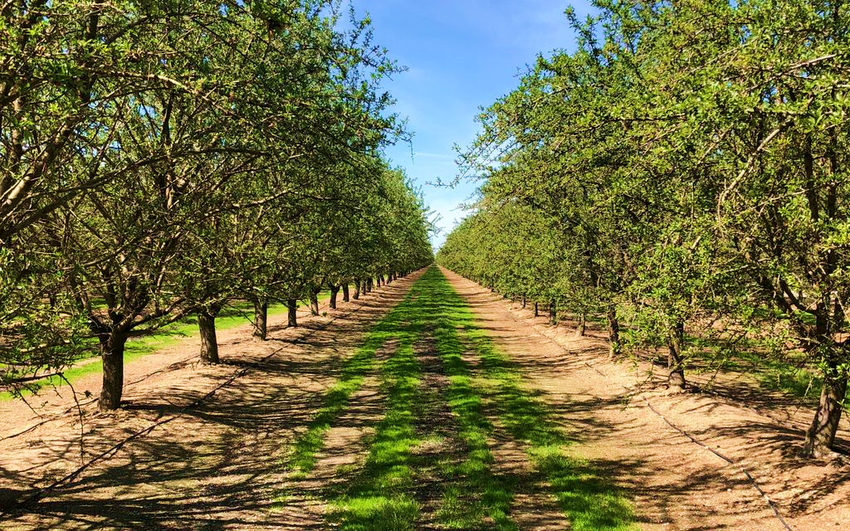
Request for Feedback: Review of Domestic Well Mitigation Fee for Madera Subbasin
Madera County Groundwater Sustainability Agency, Groundwater Sustainability Project
GSA Committee Meeting
June 3, 2025

Slide 4
2022 Rate Study
Land Repurposing
Recharge
Water Purchasing
Domestic Well Mitigation
Five-Year Averaged | FYE 2023 | FYE 2024 | FYE 2025 | FYE 2026 | FYE 2027
$ / Enrolled Acre | $246 | $246 | $246 | $246 | $246
4

Slide 5
Domestic Well Mitigation Program
Agreed to by GSAs in the Madera Subbasin to allow for continued drawdown in water levels
Transition Water within the annual allocation through 2040
The Domestic Well Mitigation program does not add water to the subbasin
Absent the other Rate Study projects water allocation in the Madera Subbasin will go to the Sustainable Yield of 13 inches in 2040
5

Slide 6
Domestic Well Estimates
Timing: Backlog of 247 de-watered wells across the Madera Subbasin as of April 2025
Currently receiving interim service from Self Help Enterprises (SHE)
Future annual replacements of 120 wells based on hydrology modeling
Program Cost Share: County GSA share estimated at 73%
Well Costs:
$35k per well in FY 2025
10% administration / management
$$Rate=\frac{Costs}{Enrolled Acreage}$$
6

Slide 7
Dry Well Estimation - Madera Subbasin
Description | Count
Backlog (SHE Interim Services) | 247
Estimated Dry Wells 2026 through 2030 | 601
Total Dry Well Replacements 2026-2030 (Backlog + Five-Year Estimate) | 848
Madera County GSAs Responsibility | 73%
Total Dry Well Replacement Madera GSAs 2026-2030 | 621
Annual Five-Year Average Replacement Rate (621 / 5 years = 124.2) | 124¹
¹ Rounded to the nearest whole number

Slide 8
Well Replacement Cost Estimates
Historical Estimates | Cost ($)
Rate Study Estimate – 2022 | $30,960
Previous Estimated Well Replacement Costs – 2024 | $35,000
Chowchilla Subbasin Well Replacements – 2024 | $25,000 – $30,000
2025 Estimates | Cost ($)
Average Recent Well Replacement Cost | $35,000

Slide 9
Domestic Well Capital Costs – Sample Calculation (Cash Funded 3-Year Backlog at $35k)
 | Component | FYE 2026 | FYE 2027 | FYE 2028 | FYE 2029 | FYE 2030
A | Well Replacement Cost¹ | $35,000 | $36,050 | $37,132 | $38,245 | $39,393
B | Capital Cost Escalation Factor |  | 3% | 3% | 3% | 3%
A X B = C | Well Replacement Cost | $35,000 | $36,050 | $37,132 | $38,245 | $39,393
D | Annual Well Replacements | 88 | 88 | 88 | 88 | 88
E | Backlog Well Replacements^{2,3} | 60 | 60 | 60 | 0 | 0
D + E = F | Total Well Replacements | 148 | 148 | 148 | 88 | 88
C X F = G | Annual Replacement Costs | $5,180,000 | $5,335,400 | $5,495,462 | $3,365,599 | $3,466,567
H | Program Management Cost - % | 10% | 10% | 10% | 10% | 10%
G X H = I | Program Management Costs | $518,000 | $533,540 | $549,546 | $336,560 | $346,657
G + I | Total – Program Costs | $5,698,000 | $5,868,940 | $6,045,008 | $3,702,159 | $3,813,224
¹ Base year is fiscal year ending (FYE) 2026
² Assumes the backlog of wells are resolved after three years
³ Represents County GSA share (73%)

Slide 10
Fee per Enrolled Acre – Sample Calculation (Cash-Funded 3-Year Backlog at $35k)
Domestic Wells Total Costs | FYE 2026 | FYE 2027 | FYE 2028 | FYE 2029 | FYE 2030
Total Program Costs | $5,698,000 | $5,868,940 | $6,045,008 | $3,702,159 | $3,813,224
Madera Subbasin Enrolled Acreage | 88,082 | 88,082 | 88,082 | 88,082 | 88,082
Total - $/Enrolled Acre | $64.69 | $66.63 | $68.63 | $42.03 | $43.29
Averaged $/Enrolled Acre | $67.00 | $67.00 | $67.00 | $43.00 | $43.00

Slide 11
Fee Comparison by Year ($/Enrolled Acre): Cash versus Debt Financed
Funding Scenario | FYE 2026 | FYE 2027 | FYE 2028 | FYE 2029 | FYE 2030 | 5-Yr Average
Cash Funded | $67 | $67 | $67 | $43 | $43 | $57
Debt Funded | $51 | $51 | $51 | $51 | $51 | $51
Due to pending litigation debt financing is currently not an option
¹ The fee is revisited annually to ensure alignment with actual expenditures.
² Assumes a backlog resolution of 3 years.

Slide 12
For Discussion Today
Backlog resolution timeline
Well replacement cost estimate
Program management cost estimate
Maintaining an averaged rate
Penalty Revenue Options
Applied towards Domestic Well Mitigation costs
Purchase of excess carryover water from willing growers
Next Steps
Incorporate feedback into July 1 GSA Committee Meeting
Board of Directors Meeting on July 8
12

Slide 13
Item 5
Action Items: Consideration and Recommendation to the Board of Directors to enter into LandFlex-related contract amendments for land repurposing:
Kamal Jawad
C&J Ranch, LLC
RRR Ranch Trust

Slide 14
LandFlex – Crop ET Savings for DWR Reimbursable Drought Relief Payment
2023-2040 Land Repurposing Program through DWR
Allocations were required to participate
Madera County GSA in the Madera Subbasin only
Purpose: To maximize domestic well protection with land repurposing
Payments have three parts and were made based on:
Drought relief
Elimination of groundwater overdraft
Orchard removal/Crop transition
Proposed contract amendments add funds for Drought Relief savings and Air Board requested changes

Slide 15
C&J Ranch, LLC – 40 acres
Payment Type | Old Payment | New Payment
Drought Relief | $350/AF x 2.31 AF/AC x 40 AC = $32,340 | $350/AF x 2.581885 AF/AC x 40 AC = $36,146.39
Elimination of Groundwater Overdraft | $1,000/AF x 1.25 AF/AC x 40 AC = $50,000 | $1,000/AF x 1.25 AF/AC x 40 AC = $50,000
Orchard Removal/Crop Transition | $2,800/AC x 40 AC = $112,000 | $2,800/AC x 40 AC = $112,000
Totals | $194,340 | $198,146.39
Additional payment owed: $3,806.39

Slide 16
Kamal Jawad – 24.55 acres
Payment Type | Old Payment | New Payment
Drought Relief | $350/AF x 2.31 AF/AC x 24.55 AC = $19,848.68 | $350/AF x 2.694356 AF/AC x 24.55 AC = $23,151.25
Elimination of Groundwater Overdraft | $1,000/AF x 1.25 AF/AC x 24.55 AC = $30,687.50 | $1,000/AF x 1.25 AF/AC x 24.55 AC = $30,687.50
Orchard Removal/Crop Transition | $2,800/AC x 24.55 AC = $68,740 | $2,800/AC x 24.55 AC = $68,740
Totals | $119,276.18 (was rounded to $119,276.00 in the original contract) | $122,578.75
Additional payment owed: $3,302.75

Slide 17
RRR Ranch Trust – 5 acres
Payment Type | Old Payment | New Payment
Drought Relief | $350/AF x 2.31 AF/AC x 5 AC = $4,042.50 | $350/AF x 3.3881 AF/AC x 5 AC = $5,929.18
Elimination of Groundwater Overdraft | $1,000/AF x 1.25 AF/AC x 5 AC = $6,250 | $1,000/AF x 1.25 AF/AC x 5 AC = $6,250
Orchard Removal/Crop Transition | $2,800/AC x 5 AC = $14,000 | $2,800/AC x 5 AC = $14,000
Totals | $24,292.50 (was rounded to $24,293.00 in the original contract) | $26,179.18
Additional payment owed: $1,886.18

Slide 18
Staff Recommendation
Consideration and Recommendation to the Board of Directors to enter into LandFlex-related contract amendments for land repurposing

Slide 19
Item 6
Action Item: Consideration and Recommendation to the Board of Directors to enter into a Cost Sharing Memorandum of Understanding (MOU) for the Madera Subbasin Joint Groundwater Sustainability Plan (GSP) Five-Year Evaluation and Plan Amendment.
15

Slide 20
Cost Share MOU – Madera GSP
Costs include periodic evaluation and plan amendment
Costs were shared between four parties
Madera County (GSA)
City of Madera (GSA)
Madera Irrigation District (GSA)
Madera Water District (GSA)
Costs were offset by an additional Prop 68 grant to cover groundwater model updates
Cost sharing agreement lagged behind billing so billing could be completed (March/April)
Notes:
Cost share Memorandum of Understanding (MOU), Madera GSP
Cost to be shared
Madera County –GSA
City of Madera GSA
Madera Irrigation District
Costst were offset by funding fromProp 68 Grant

Slide 21
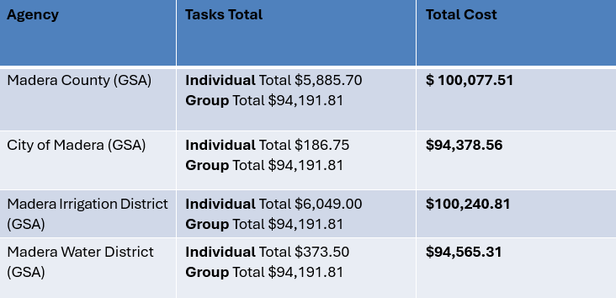
4 Party Cost Share
Madera Subbasin Joint GSP Five-Year Periodic Evaluation and Plan Amendment
Task 1:Conduct Project Management and Coordination
Task 2:Participate in Project Technical Meetings and Outreach
Task 3:Facilitate Planning and Coordination Meeting between GSAs and Subbasins
Task 4:Evaluate and Update GPS Implementation
Task 5:Reevaluate and Revise GSP Content
16

Slide 22
Staff Recommendation
Consideration and recommendation to the Board of Directors to enter into a Cost Sharing MOU for the Madera Subbasin Joint GSP Five-Year Evaluation and Amendment in the amount of $389,262.19.

Slide 23
Item 7
Action Item: Consideration and recommendation to the Board of Directors to approve Transfer of Appropriations No. 24-148 in the amount of $35,633.00 from Water & Natural Resources – County GSAs – Interfund Revenue to Intrafund Revenue for Fiscal Year 2024-2025 to reimburse the County GSAs budget for staff time spent on Drought activities.
Notes:
This item is to recommend approval to the Board of Directors for

Slide 24
Background on the Reimbursement and Budget Adjustment for the GSA
For this FY 24-25, the Drought budget will need to reimburse the County GSA $35,633 for GSA staff time spent on Drought activities.
To complete the reimbursement within the internal County Financial system, both the County GSA budget and the Drought budget must have accounts that work together:
County GSA needs: Intrafund Revenue Account 670000
Drought Budget will use: Intrafund Expense Account 770100
Since the County GSA budget is receiving revenue, it needs to have 670000 in the budget, but it currently only has Interfund Revenue Account 662800; therefore, $35,633 needs to be moved from:
Interfund Revenue Account 662800 to
Intrafund Revenue Account 670000
Notes:
This item is to recommend approval to the Board of Directors for

Slide 25
Summary of Transfer of Appropriations No. 24-148
TOA No. 24-148 is required to adjust internal accounting entries within the County GSAs budget for FY 2024-2025.
Reallocates $35,633 from:
Interfund Revenue (05950-662800) to Intrafund Revenue (05950-670000)
Ensures the Intrafund account is used to receive reimbursement from the Drought budget.
Reimbursement is for GSA staff time spent on Drought activities.
This is an administrative adjustment only — it does not introduce new revenue.
Notes:
This item is to recommend approval to the Board of Directors for

Slide 26
Staff Recommendation
Recommendation to the Board of Director to Approve TOA No. 24-148 to adjust internal accounting entries.
Notes:
This item is to recommend approval to the Board of Directors for

