Slide 1

IrriWatch Platform Overview – 2026 season
Madera Growers Workshop – Feb 2026
hydrosat.com

Slide 2
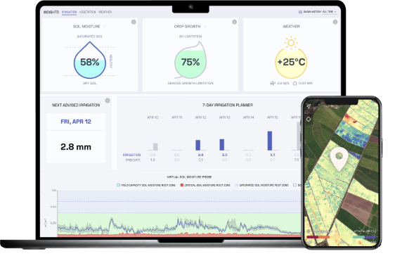
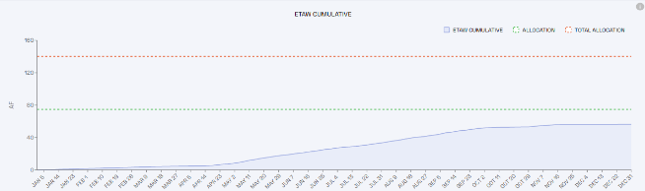
Does Hydrosat provide a platform to track my water use?
The Hydrosat tool/platform for water use monitoring is called IrriWatch
Can be accessed via: https://irriwatch.hydrosat.com/
To access your farm unit, parcels and parcel-fields data you need a valid email address
Existing users can use the same username (email) & password as previous years

Slide 3
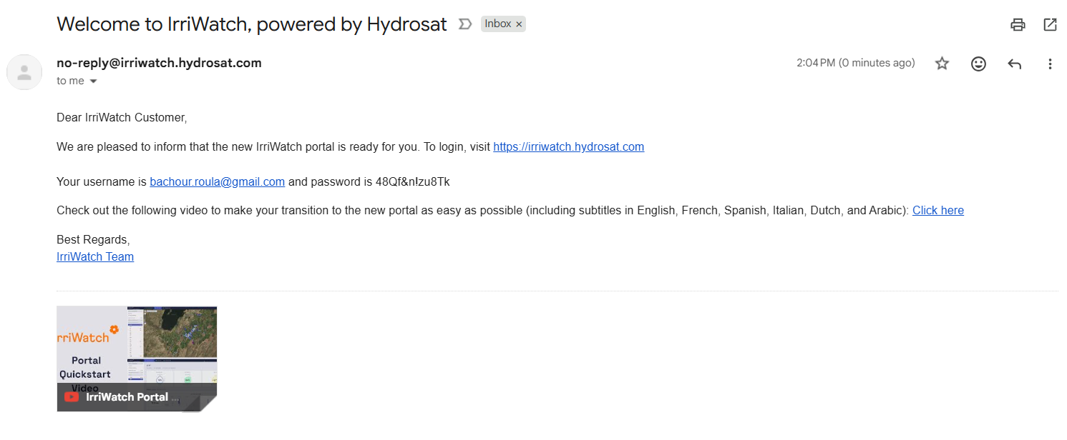
I have never accessed IrriWatch platform before, how can I get a log in?
Once the season starts and the data is generated, if your email is in the GSA database, you will receive an invite like this to your email address:

Slide 4
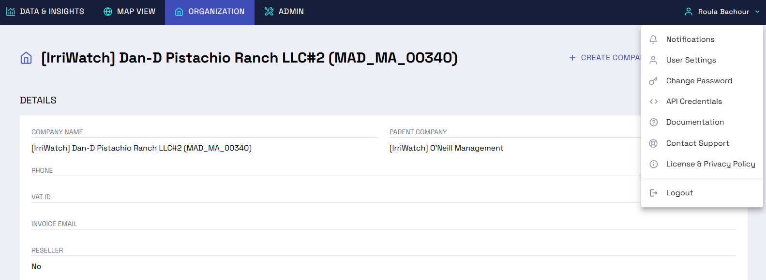
User Settings (Language, Units, Date formats, Documentation, etc.)
Can I change my password or other settings?

Slide 5
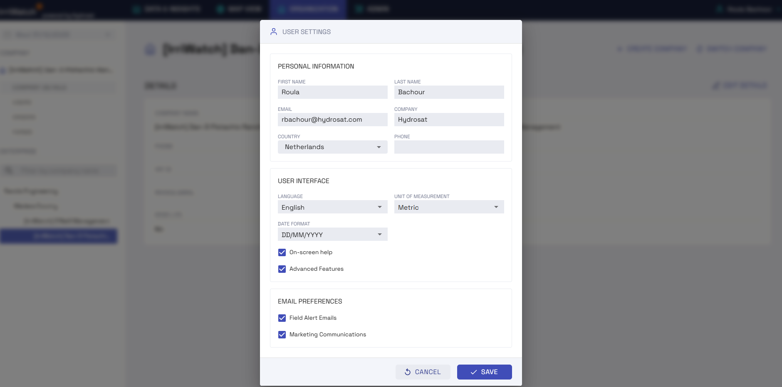
Can I change my password or other settings?

Slide 6
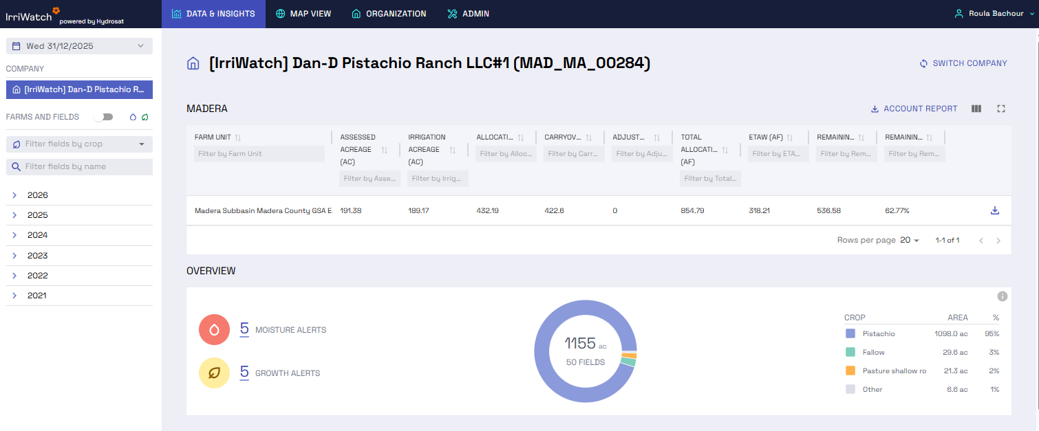
What do I see after I am logged in?
Data & Insights overview:
showing budget tables for your farm units
Notes:
Overview of assessed acreage in each farm unit, allocation, carryover. Recharge, surface water, appeals etc. will be under adjustment and it can pop later during the season as it happens

Slide 7
Where are my Account Report?
Latest Account Reports can be downloaded here
When at Company (Account) Level, you see Account Level (and Farm Unit) budget Tables
Latest Farm Units Reports can be downloaded here

Slide 8
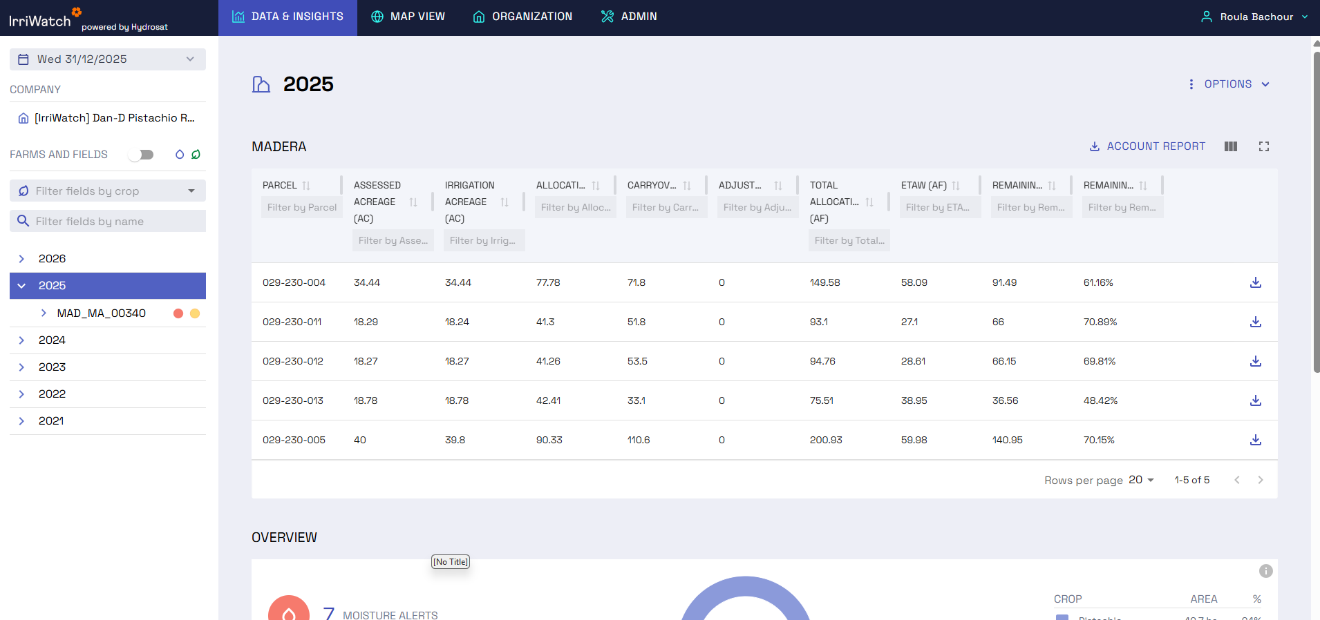
What about my parcels budgets and reports?
When at Year (Farm) Level, you get an overview budget tables for all parcels
Latest Parcel Reports can be downloaded here

Slide 9
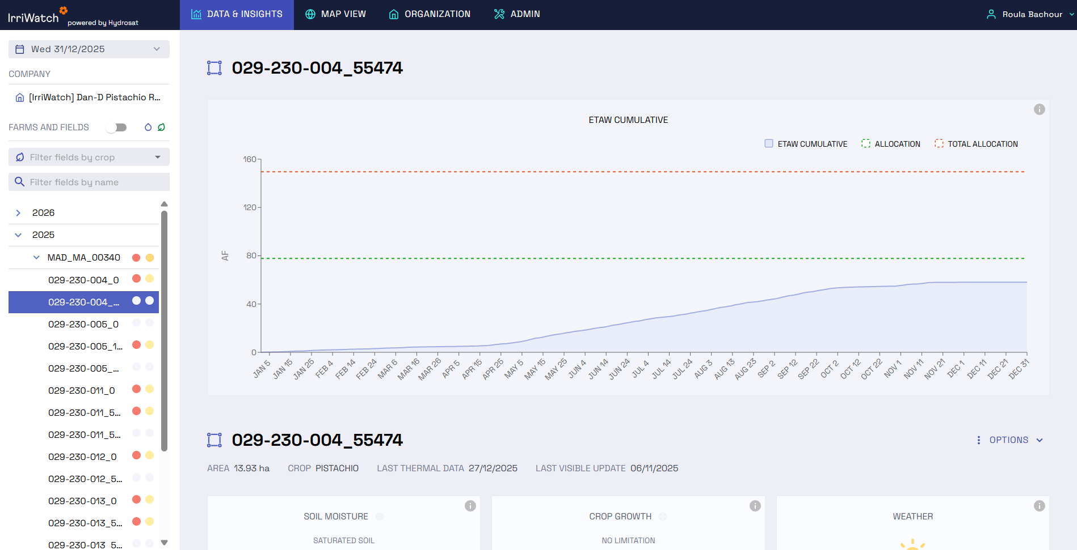
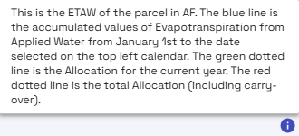

How much water am I using? Parcel level ETAW
Parcel level water use tracking, updated on daily basis
Unfold this to see all parcel-field
Hover over the info button to get more explanation

Slide 10
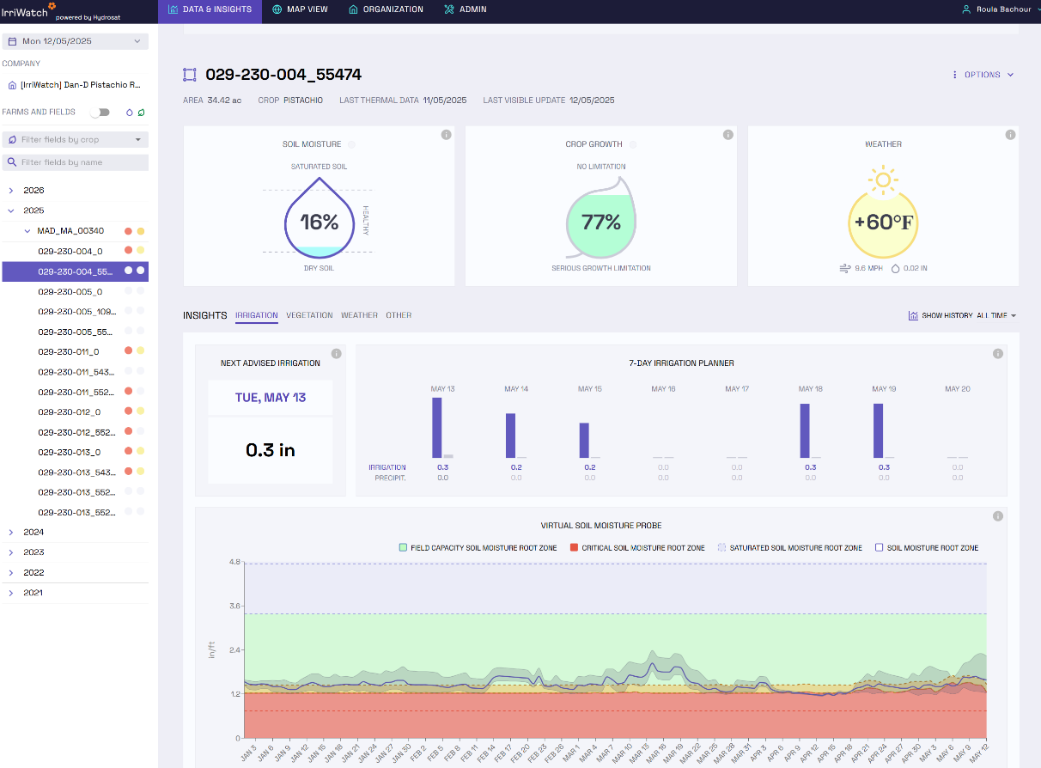
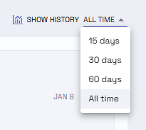
What else can I see? Can I also download the data?
Downloading data for parcel-fields

Slide 11
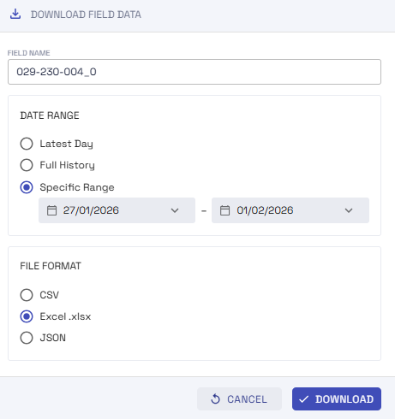

What else can I see? Can I also download the data?
Downloading data for parcel-fields

Slide 12
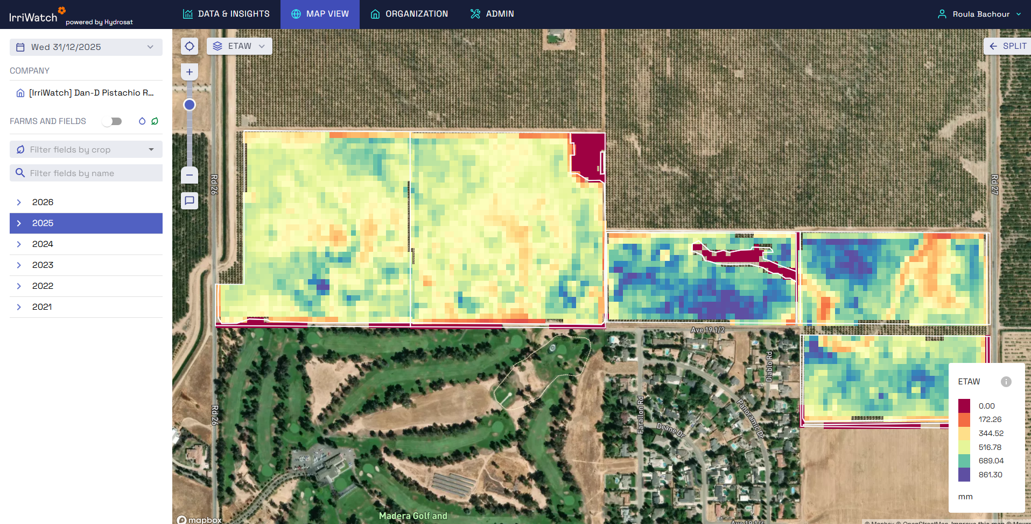
Map View – Where are the maps of my parcel-fields?
Maps View

Slide 13
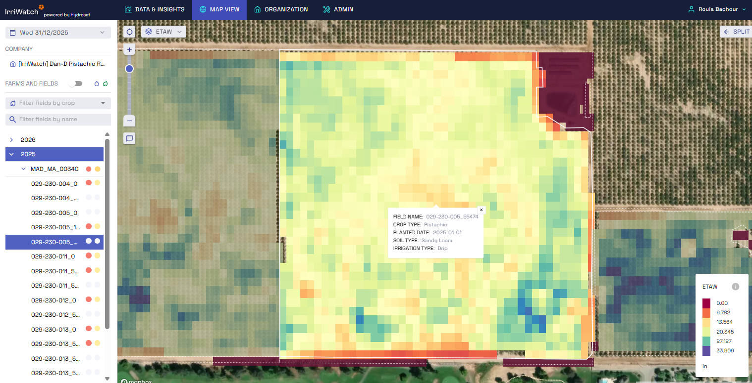
Map View – Where are the maps of my parcel-fields?
Select a parcel-field to zoom in and see more details

Slide 14
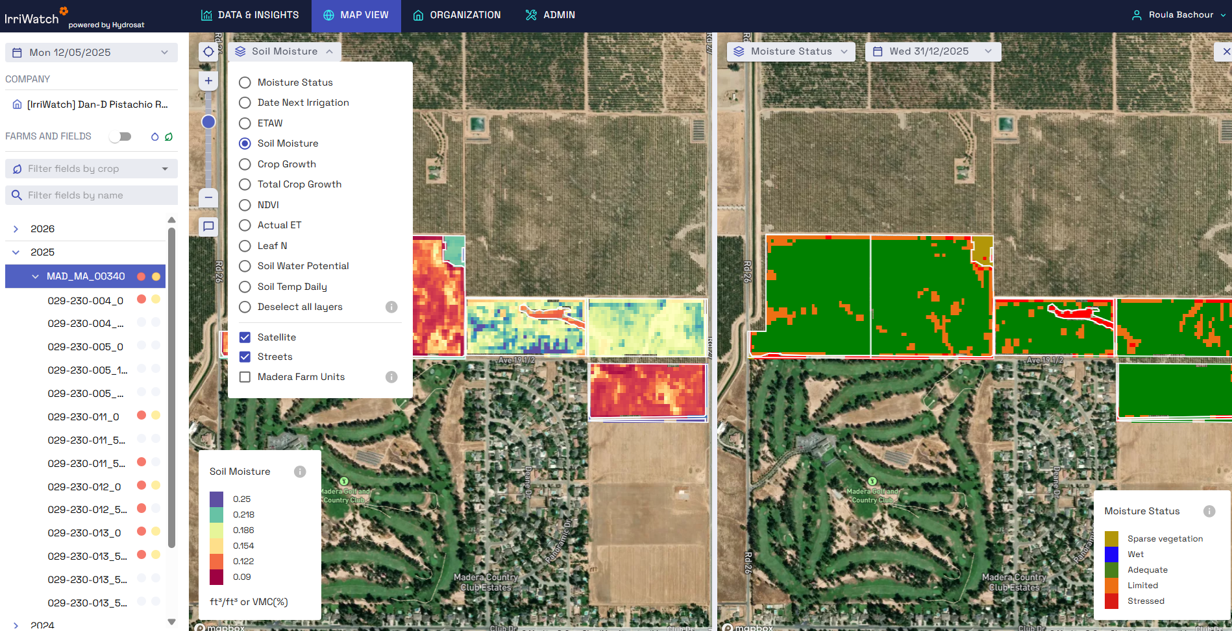
Map View – Can I see other maps?
Additional layers available and possibility for Split screen

Slide 15
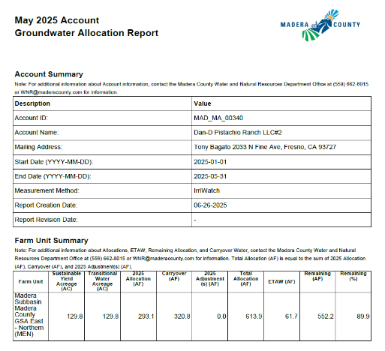
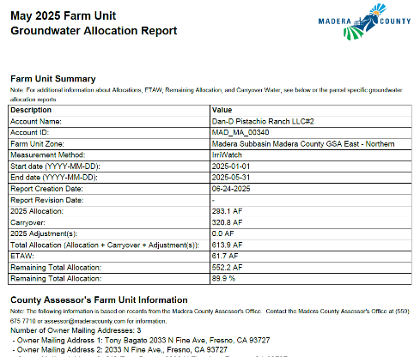
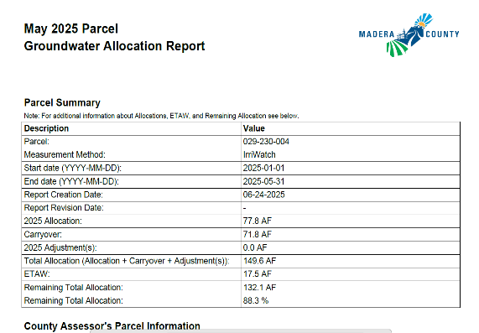
Reporting Process
IW Data is near real-time and is generated at daily time steps
Reporting is done at the end of each the month
Davids Engineering (DE) processes IW data and generates reports
Reports are emailed, uploaded and mailed each month
IW Data is near real-time → adjustments may happen
Notes:
This related to data quality and consistencies checks which may results in some adjustment (this happened in 2022 and 2023)

Slide 16
2026 Season Kickoff
Growers’ Workshop – IrriWatch intro / Q&A (Feb 2026)
Final boundaries, ownership, allocations, etc. for 2026 received (Mar 2026)
Set up of all fields on IrriWatch Platform (Mar 2026)
Accounts creation, initialization of the data and start of processing
Access provided to all (new) users (Mar 2026)
First reports generated (Mar 2026)
IrriWatch Support (Jan-Dec)

Slide 17
I have other questions!
What if I don’t get an invitation email? How do I know if my email is in the system?
How can I add more users to my account?
What if something is wrong with my account (acreage, allocation, parcels, etc.)
How can I access older reports?
Others?
→ CONTACT YOUR WATER RESOURCES SPECIALISTS
Tukta Phetasa – 559.514.4819
Aleta Allen – 559.831.7166
Letty Tapia – 559.831.7172
Jacinta Cabral – 559.831.7173

Slide 18

Thank you
hydrosat.com

